Slide 1
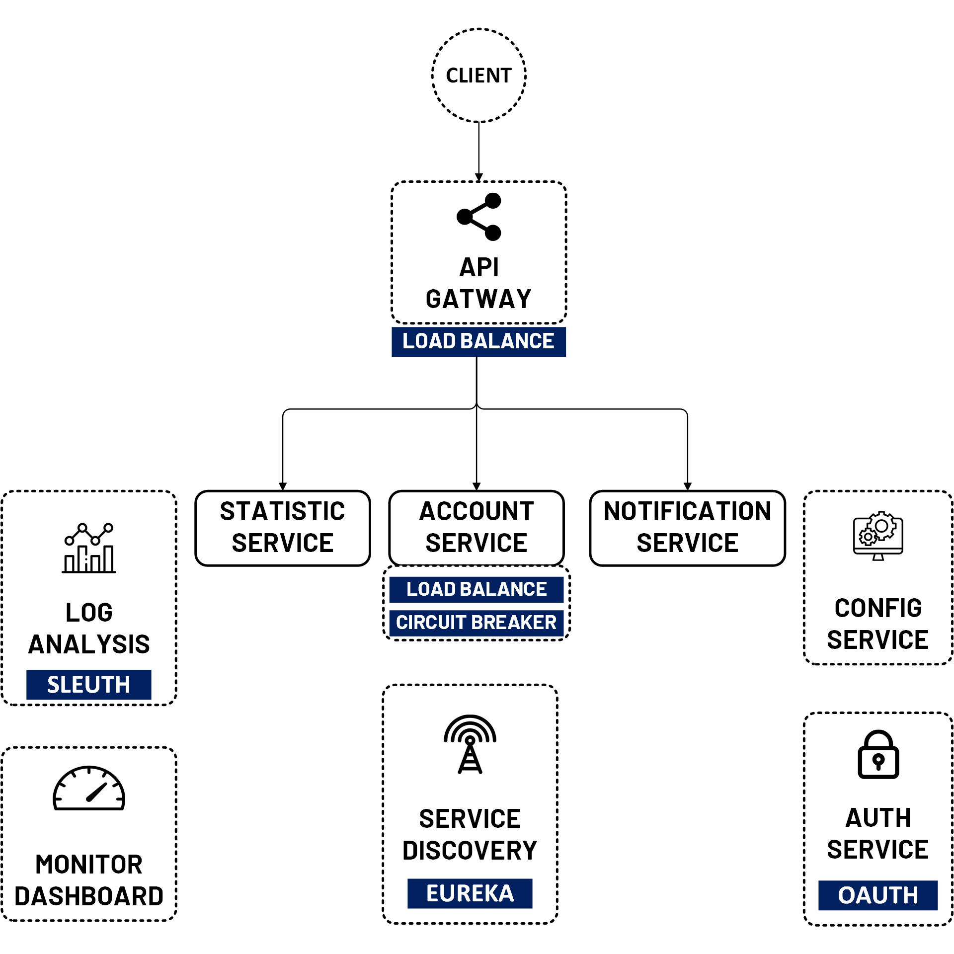

OAuth 2 Security Resource Server
www.jmaster.io/course/microservices-with-spring-cloud

